Slide 1
Improved Source of Drinking Water
CAPSTONE PROJECT
Presented By:
Karthick Raja K - Christian College of Engineering and
Technology - CSE

Slide 2
OUTLINE
Problem Statement (Should not include solution)
Proposed System/Solution
System Development Approach (Technology Used)
Algorithm & Deployment
Result (Output Image)
Conclusion
Future Scope
References

Slide 3
Problem Statement
Access to safe and improved drinking water continues to be a major concern in many parts of India, especially in rural and underdeveloped regions. Despite national efforts and international goals under the Sustainable Development Goals (SDGs), significant disparities still exist across states, districts, and population groups.
These inequalities affect health, education, and overall well-being, highlighting the urgent need to better understand how water access varies regionally and socially.

Slide 4
Proposed Solution
The proposed system aims to assess disparities and trends in access to improved drinking water across Indian states and sectors using data-driven insights. This involves leveraging data visualization and analytical tools available on IBM Watsonx.ai to identify key patterns, outliers, and gaps in water access. The solution consists of the following components:
Data Collection:
Utilized the 78th Round of the Multiple Indicator Survey (MIS) dataset.
Focused on indicators such as:
Access to improved sources of drinking water
Sector-wise classification (Urban/Rural/All)
Clean cooking fuel usage
Migration-related trends
Data Preprocessing
Uploaded the CSV dataset into IBM Watsonx.ai Studio.
Cleaned and formatted the data for visualization.
Converted categorical fields and normalized missing values to ensure accurate representation.

Slide 5
Proposed Solution
Exploratory Data Analysis (EDA) & Visualization:
Created multiple chart types (bar, pie, histogram, Pareto) to:
Compare Urban vs. Rural access by state
Identify states with lowest and highest water access
Analyze percentage distributions and data concentration
Understand sector-wise household data distribution
Deployment:
Deployed and executed analysis on IBM Cloud (Lite Plan) using Watsonx.ai no-code dashboard.
Visual outputs served as an interactive layer for decision-making and reporting.
Evaluation:
Interpreted visual insights to identify key problem areas.
Compared trends across sectors and states.
Derived actionable insights for policy-level recommendations in achieving SDG goals.

Slide 6
System Approach
The "System Approach" outlines the overall strategy and tools used for analyzing water accessibility in India. The project follows a data-driven and visualization-based methodology using IBM Cloud services.
System Requirements:
Platform: IBM Cloud (Lite Plan)
Tool Used: Watsonx.ai Studio
Data Format: CSV file from NSS 78th Round – Multiple Indicator Survey (MIS)
Internet: Required for cloud access and deployment
User Access: IBM Cloud account and Watson Studio access
Libraries/Tools Used:
Built-in data visualization tools (bar chart, pie chart, histogram, Pareto analysis)
Auto data summarization and column transformation tools
Watsonx.ai dashboard components for dragging and dropping analysis blocks
Chart building interface for categorical and numerical fields

Slide 7
Algorithm & Deployment
Algorithm:
Since the project focuses on descriptive analytics, no machine learning algorithm was applied. Instead, the project used:
Statistical visualization techniques to identify patterns and disparities
Chart-based comparative analysis between:
Urban vs. Rural access to improved drinking water
State-wise distribution of access
Sector-wise insights using pie, bar, histogram, and Pareto charts
Input Features:
State/UT name
Sector (Urban, Rural, All)
Percentage of population with improved water access
Related indicators like clean cooking fuel and migration status

Slide 8
Algorithm & Deployment
Deployment Process:
The entire solution was deployed and executed using IBM Watsonx.ai on IBM Cloud Lite.
Key steps:
CSV Dataset uploaded into Watsonx.ai
Data prepared using Watsonx’s transformation tools
Dashboards built with drag-and-drop visualization widgets
Charts exported as images and included in the project results
Outcome:
A fully interactive, visual representation of disparities in water access
No-code solution enabled rapid, accurate insight generation without writing any ML code
Charts used as direct outputs for evidence-based understanding

Slide 9
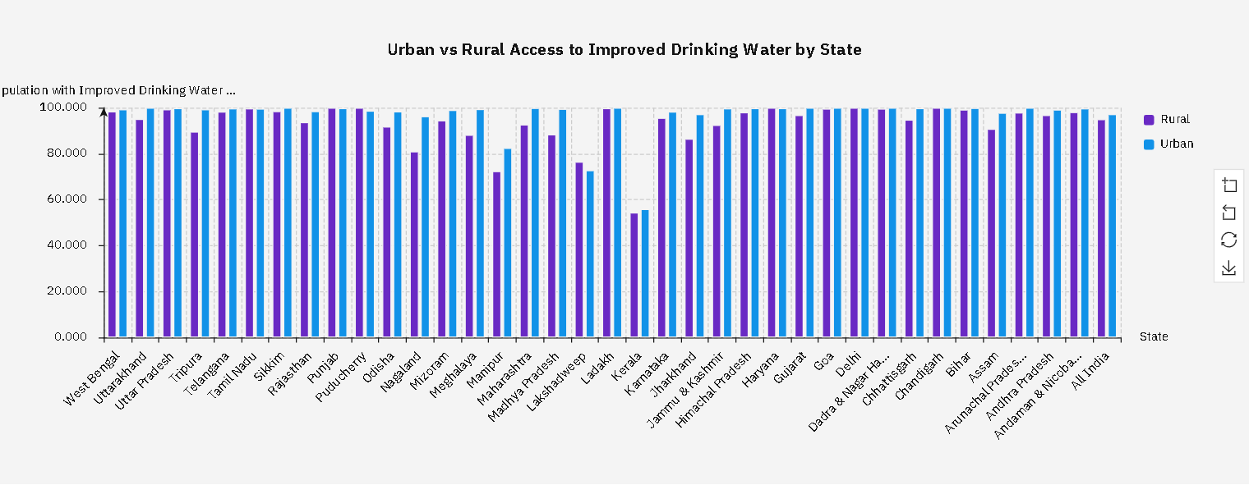
Result
Key Findings:
1. Urban areas showed significantly higher access to improved drinking water sources compared to rural regions.

Slide 10
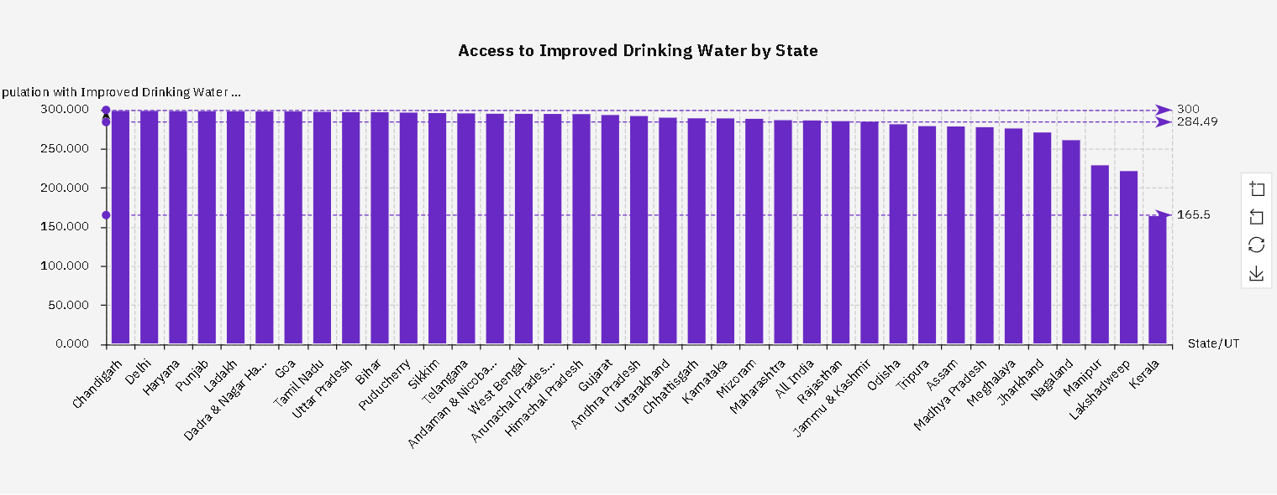
Result
2. Certain states and union territories had noticeably lower access levels, indicating the need for targeted interventions.

Slide 11
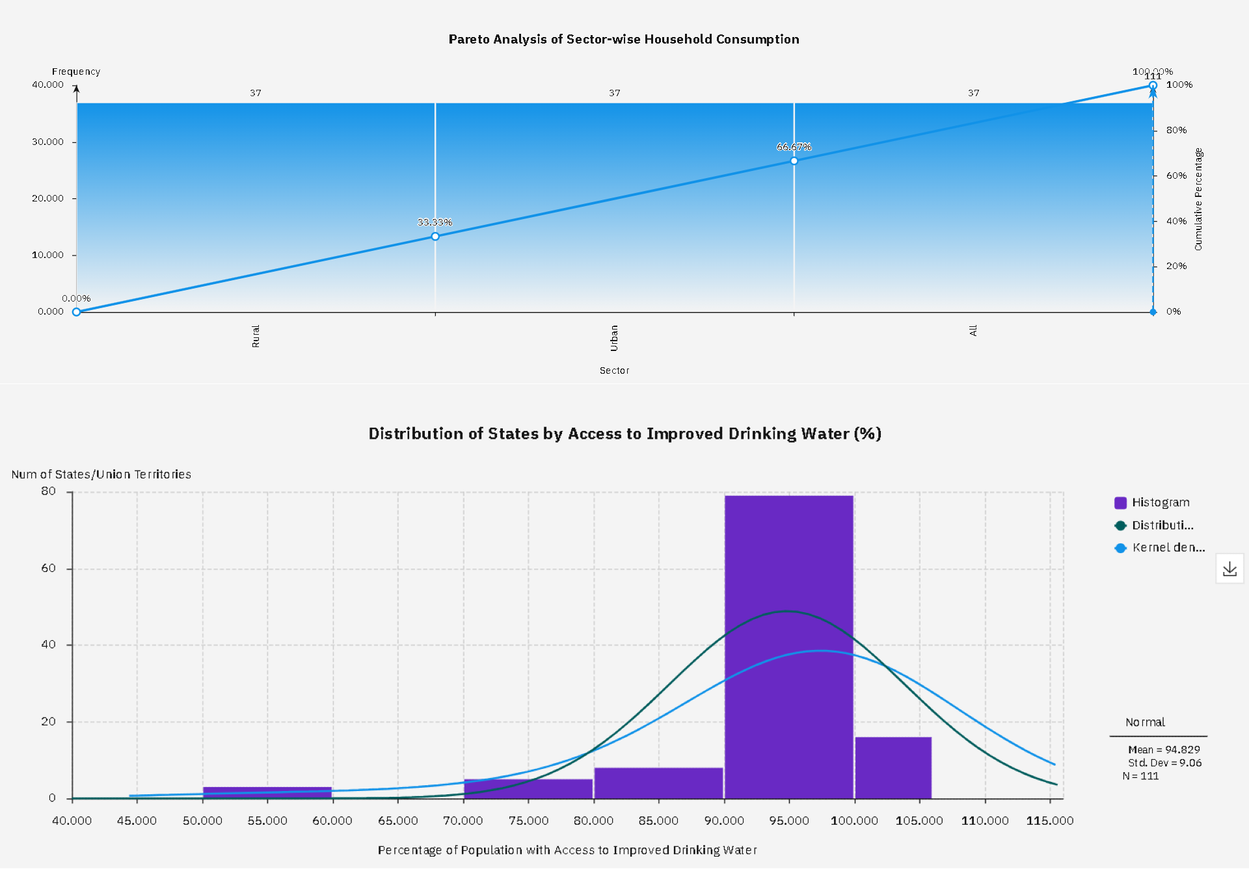
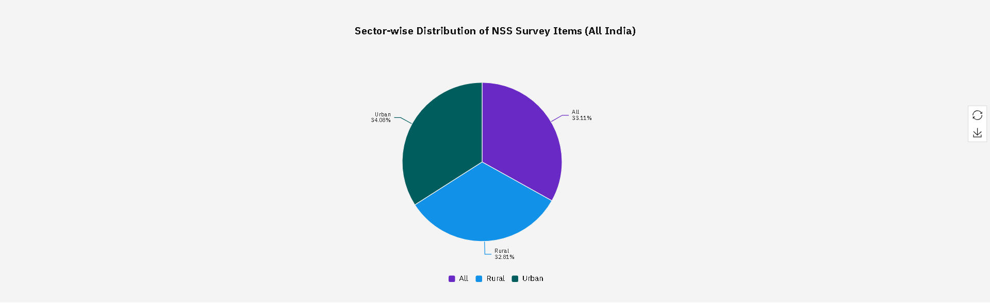
Result
3. Pie and bar charts revealed the proportion of households by sector with and without improved water sources.
4. The Pareto chart helped identify the top contributing states to water access inequalities.
5. The histogram displayed the frequency distribution of access percentages across all states.

Slide 12
Conclusion
The project successfully analyzed data from the 78th Round of the Multiple Indicator Survey to understand the state-wise and sector-wise access to improved drinking water in India. Using IBM Watsonx.ai’s no-code platform, we identified significant disparities in water access between urban and rural areas, as well as among different states.
The visualizations provided clear evidence of inequality, which can help guide future government policies and resource allocation. The project also demonstrated how cloud-based data tools can empower non-programmers to extract meaningful insights from public datasets.
This analysis contributes directly to supporting India’s progress toward Sustainable Development Goals (SDG 6 – Clean Water and Sanitation) by enabling data-driven decision-making and identifying priority areas for intervention.

Slide 13
Future scope
Incorporate real-time water quality data (e.g., contamination levels, pH) to assess not just access but safety.
Integrate with sanitation and health datasets to explore the broader impact of water access on public health.
Use machine learning models in future to predict water-stressed regions and seasonal shortages.
Develop a public dashboard for policymakers to monitor progress on SDG 6 at the district level.
Extend the analysis to include rainfall, groundwater levels, and climate impact on drinking water availability.

Slide 14
References
National Sample Survey Office (NSSO) – 78th Round: Multiple Indicator Survey (MIS)
Ministry of Statistics and Programme Implementation (MoSPI), Government of India
United Nations Sustainable Development Goals – Goal 6: Clean Water and Sanitation
IBM Cloud and Watsonx.ai Studio Documentation – https://cloud.ibm.com
Edunet Foundation – AICTE Internship Support Material
Research articles and public datasets related to rural water access and migration trends

Slide 15
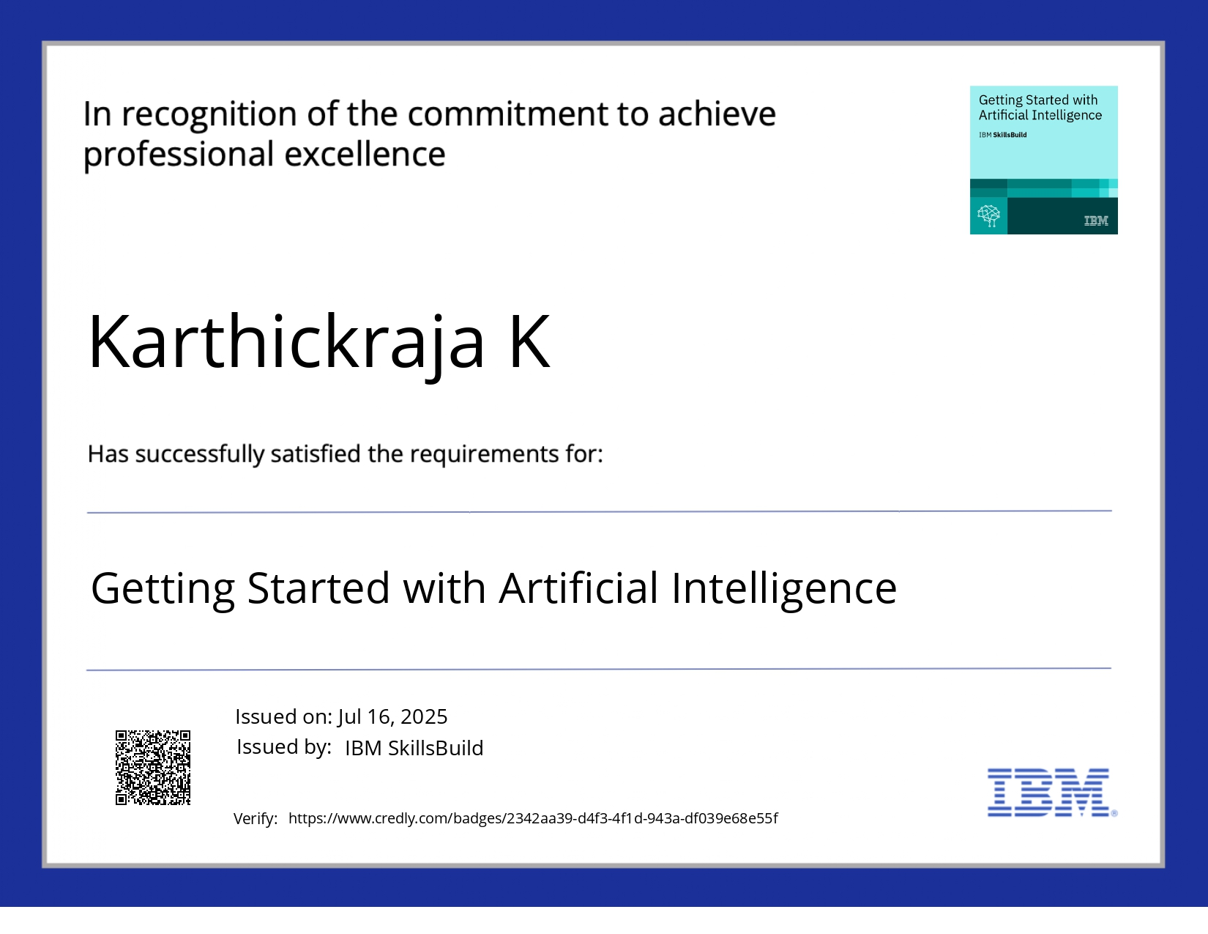
IBM Certifications

Slide 16
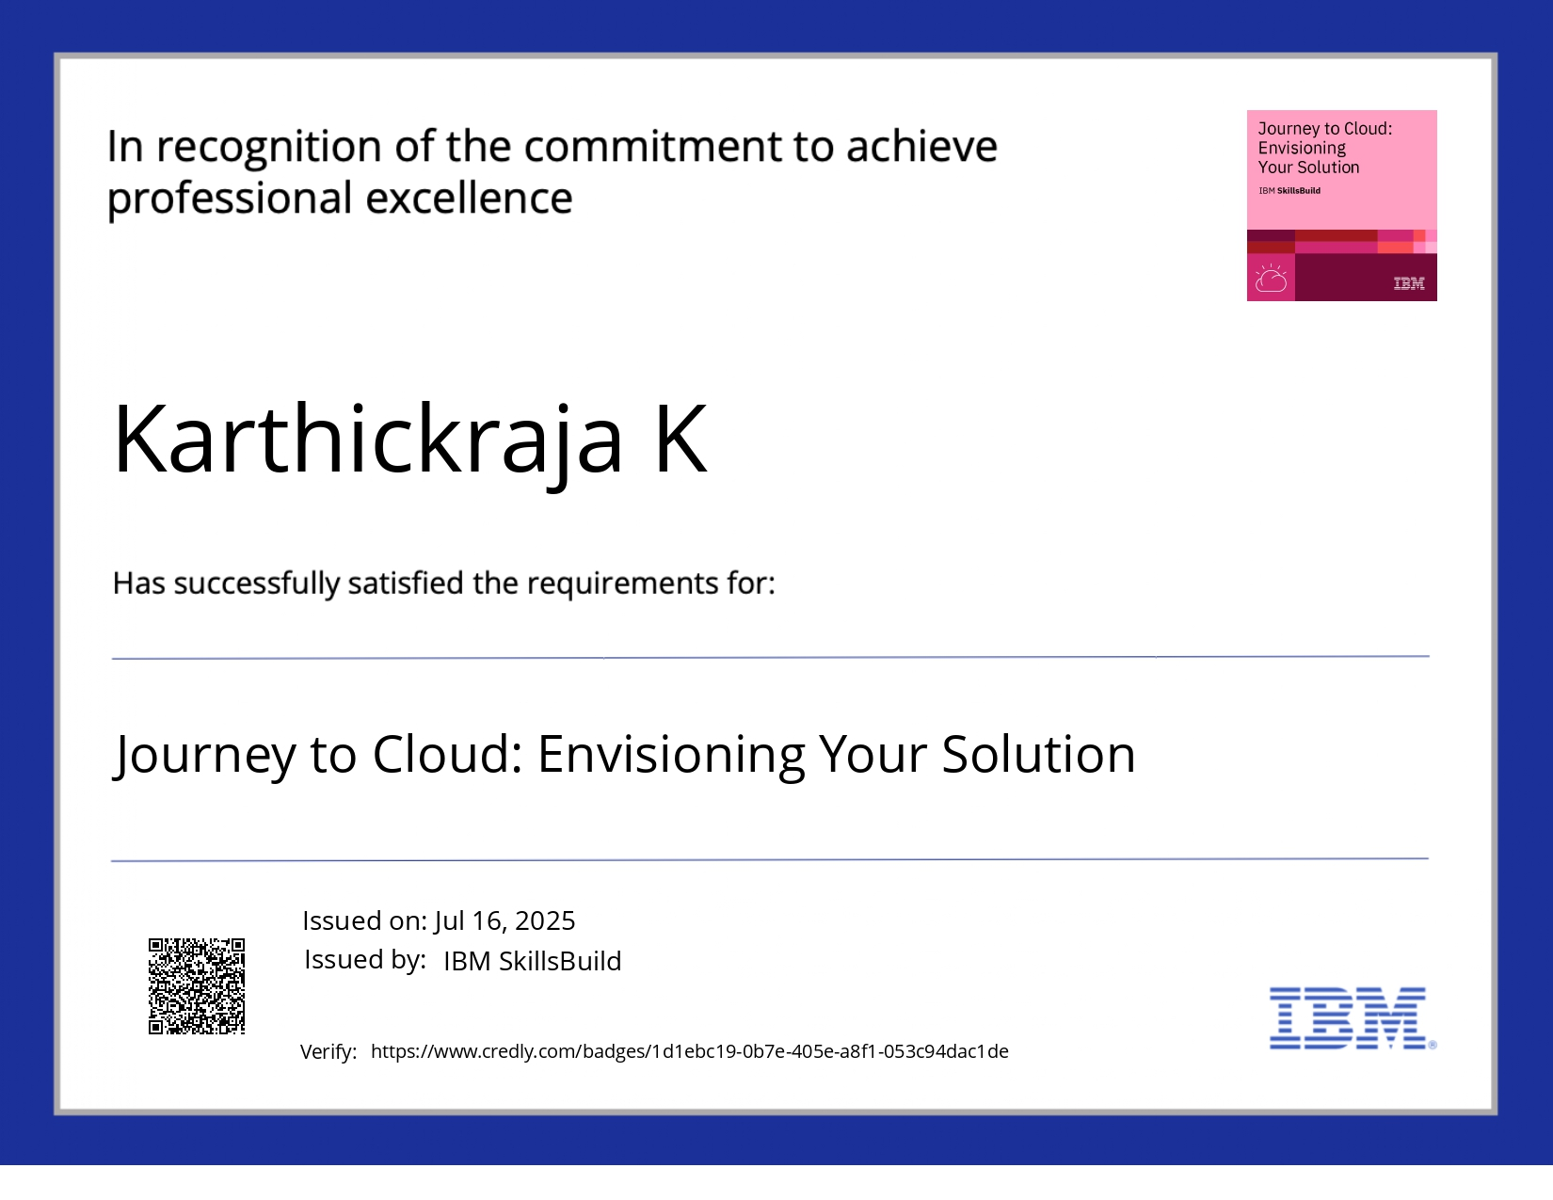
IBM Certifications

Slide 17
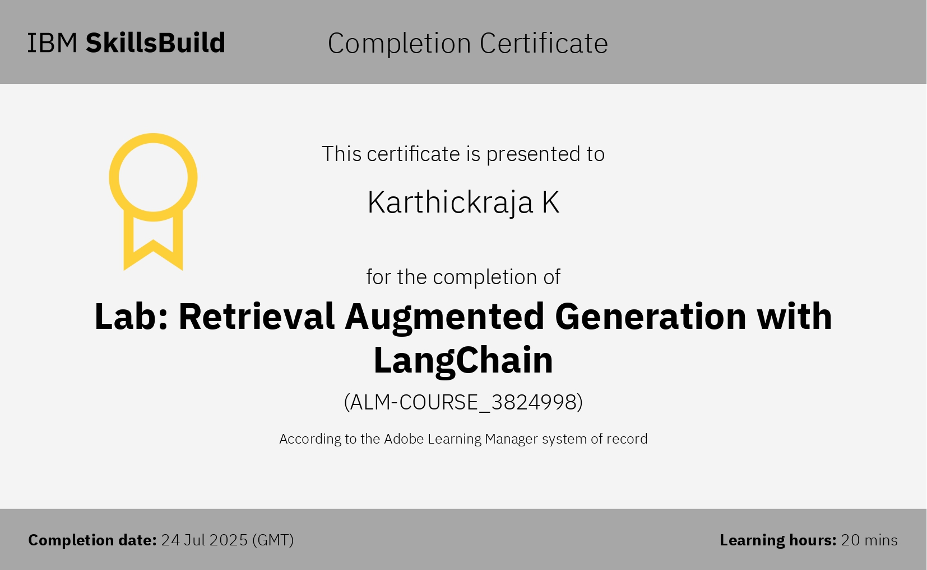
IBM Certifications

Slide 18
THANK YOU

